Slide 1

Cloud Platform Operations
Day1 – 실습2
David Yoon | CEO david@2miles.co.kr

Slide 2
AWS Terraform – provider.tf
provider.tf
provider "aws" {
region = "ap-northeast-1"
}

Slide 3
AWS VPC 만들기 – vpc.tf
vpc.tf
resource "aws_vpc" "dev" {
cidr_block = "1.0.0.0/16"
enable_dns_hostnames = true
enable_dns_support = true
instance_tenancy = "default"
tags {
Name = "dev"
}
}

Slide 4
AWS
subnet.tf
resource "aws_subnet" "public_1a" {
vpc_id = "${aws_vpc.dev.id}"
availability_zone = "ap-northeast-1a"
cidr_block = "1.0.1.0/24"
tags {
Name = "public-1a"
}
}
resource "aws_subnet" "private_1a" {
vpc_id = "${aws_vpc.dev.id}"
availability_zone = "ap-northeast-1a"
cidr_block = "1.0.101.0/24"
tags {
Name = "private-1a"
}
}
resource "aws_subnet" "public_1c" {
vpc_id = "${aws_vpc.dev.id}"
availability_zone = "ap-northeast-1c"
cidr_block = "1.0.2.0/24"
tags {
Name = "public-1c"
}
}
resource "aws_subnet" "private_1c" {
vpc_id = "${aws_vpc.dev.id}"
availability_zone = "ap-northeast-1c"
cidr_block = "1.0.102.0/24"
tags {
Name = "private-1c"
}
}

Slide 5
AWS Terraform – internet_gateway.tf
internet_gateway.tf
resource "aws_internet_gateway" "dev" {
vpc_id = "${aws_vpc.dev.id}"
tags {
Name = "dev"
}
}

Slide 6
AWS Terraform – eip.tf
eip.tf
resource "aws_eip" "nat_dev_1a" {
vpc = true
}
resource "aws_eip" "nat_dev_1c" {
vpc = true
}

Slide 7
AWS Terraform – nat_gateway.tf
nat_gateway.tf
resource "aws_nat_gateway" "dev_1a" {
allocation_id = "${aws_eip.nat_dev_1a.id}"
subnet_id = "${aws_subnet.public_1a.id}"
}
resource "aws_nat_gateway" "dev_1c" {
allocation_id = "${aws_eip.nat_dev_1c.id}"
subnet_id = "${aws_subnet.public_1c.id}"
}

Slide 8
AWS Terraform – route_table.tf (1/3)
route_table.tf
# dev_public
resource "aws_route_table" "dev_public" {
vpc_id = "${aws_vpc.dev.id}"
route {
cidr_block = "0.0.0.0/0"
gateway_id = "${aws_internet_gateway.dev.id}"
}
tags {
Name = "dev-public"
}
}
resource "aws_route_table_association" "dev_public_1a" {
subnet_id = "${aws_subnet.public_1a.id}"
route_table_id = "${aws_route_table.dev_public.id}"
}
resource "aws_route_table_association" "dev_public_1c" {
subnet_id = "${aws_subnet.public_1c.id}"
route_table_id = "${aws_route_table.dev_public.id}"
}

Slide 9
AWS Terraform – route_table.tf (2/3)
route_table.tf
# dev_private_1a
resource "aws_route_table" "dev_private_1a" {
vpc_id = "${aws_vpc.dev.id}"
route {
cidr_block = "0.0.0.0/0"
nat_gateway_id = "${aws_nat_gateway.dev_1a.id}"
}
tags {
Name = "dev-private-1a"
}
}
resource "aws_route_table_association" "dev_private_1a" {
subnet_id = "${aws_subnet.private_1a.id}"
route_table_id = "${aws_route_table.dev_private_1a.id}"
}

Slide 10
AWS Terraform – nacl.tf
nacl.tf
resource "aws_default_network_acl" "dev_default" {
default_network_acl_id = "${aws_vpc.dev.default_network_acl_id}"
ingress {
protocol = -1
rule_no = 100
action = "allow"
cidr_block = "0.0.0.0/0"
from_port = 0
to_port = 0
}
egress {
protocol = -1
rule_no = 100
action = "allow"
cidr_block = "0.0.0.0/0"
from_port = 0
to_port = 0
}
subnet_ids = [
"${aws_subnet.public_1a.id}",
"${aws_subnet.public_1c.id}",
"${aws_subnet.private_1a.id}",
"${aws_subnet.private_1c.id}",
]
tags {
Name = "dev-default"
}
}

Slide 11
AWS Terraform – security_group.tf
security_group.tf
resource "aws_default_security_group" "dev_default" {
vpc_id = "${aws_vpc.dev.id}"
ingress {
protocol = -1
self = true
from_port = 0
to_port = 0
}
egress {
from_port = 0
to_port = 0
protocol = "-1"
cidr_blocks = ["0.0.0.0/0"]
}
tags {
Name = "dev-default"
}
}

Slide 12
AWS Terraform – Bastion 네트워크에 VM 생성 bastion.tf (1/2)
bastion.tf
resource "aws_security_group" "bastion" {
name = "bastion"
description = "open ssh port for bastion"
vpc_id = "${aws_vpc.dev.id}"
ingress {
from_port = 22
to_port = 22
protocol = "tcp"
cidr_blocks = ["0.0.0.0/0"]
}
egress {
from_port = 0
to_port = 0
protocol = "-1"
cidr_blocks = ["0.0.0.0/0"]
}
tags {
Name = "bastion"
}
}

Slide 13
AWS Terraform – Bastion 네트워크에 VM 생성 bastion.tf (2/2)
bastion.tf
resource "aws_eip" "bastion_1a" {
instance = "${aws_instance.bastion_1a.id}"
vpc = true
}
resource "aws_instance" "bastion_1a" {
ami = "${var.amazon_linux}"
availability_zone = "ap-northeast-1a"
instance_type = "t2.nano"
key_name = "${var.dev_keyname}"
vpc_security_group_ids = [
"${aws_security_group.bastion.id}",
"${aws_default_security_group.dev_default.id}",
]
subnet_id = "${aws_subnet.public_1a.id}"
associate_public_ip_address = true
tags {
Name = "bastion-1a"
}
}

Slide 14
AWS Terraform – variable.tf
variable.tf
variable "amazon_linux" {
# Amazon Linux AMI 2017.03.1 (HVM), SSD Volume Type - ami-4af5022c
default = "ami-4af5022c"
}
variable "dev_keyname" {
default = "2dal-dev"
}

Slide 15
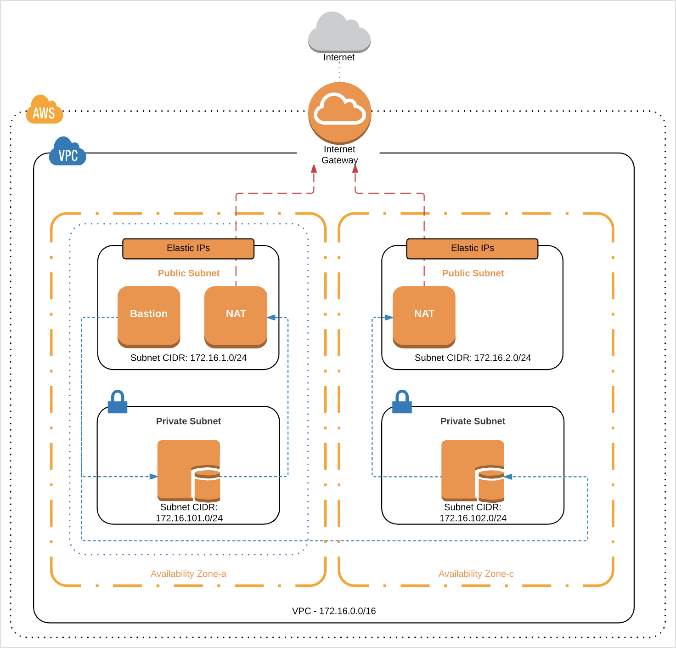

AWS Terraform – 과제
Subnet private_1a 에 VM을 생성하고 (공인IP없이) Bastion VM을 통해서 SSH 접속
1.0.1.0/24
1.0.2.0/24
1.0.101.0/24
1.0.102.0/24

Slide 16
AWS Terraform – SSH접속
접속 방법
$ssh -i ~/.ssh/2dal-dev.pem -A ec2-user@{Bastion IP} -t ssh ubuntu@{Private instance IP}

Slide 17
참고 자료
자료 출처 - https://bit.ly/2GbS5uG
GitHub참고 자료 - https://github.com/stitchlabio/terraform-up-and-running-code
GitHub참고 자료 - https://github.com/dtan4/terraforming

Slide 18
감사합니다

